Slide 1

PROS O&D Optimizer
Sameer Mohamed Ali

Slide 2
Agenda
Session - 2
Leg Re-Optimization Triggers
GUI Overview
Optimizer Parameters
Alerts

Slide 3
Leg Re-Optimization
Triggers
In addition to the flights that are optimized each night as part of the optimization schedule (network optimization) the Optimizer performs leg re-optimizations.
If any one leg requires a re-optimization then all legs of the flight are re-optimized.
A leg re-optimization performs each of the step 1, 3, 4, and 5 of the Optimization Process (i.e., with the exception of the Network Optimization)
Displacement cost from the last run of the Network Optimization will be used.

Slide 4
Leg Re-Optimization
Two ways in which leg re-optimization can be performed
User changing linked Optimizer input parameter values
Automatic leg re-optimization triggers
During the nightly processing the system evaluates various “triggers”/criteria that indicate a leg requires re-optimization.

Slide 5
Leg Re-Optimization
Trigger(s)
That require parameter/ link setting
Capacity Change
Demand Change
Show-up forecast change
That do not require any parameter setting
Equipment Change
New Flight
New Flight Leg
Leg deleted from existing flight

Slide 6
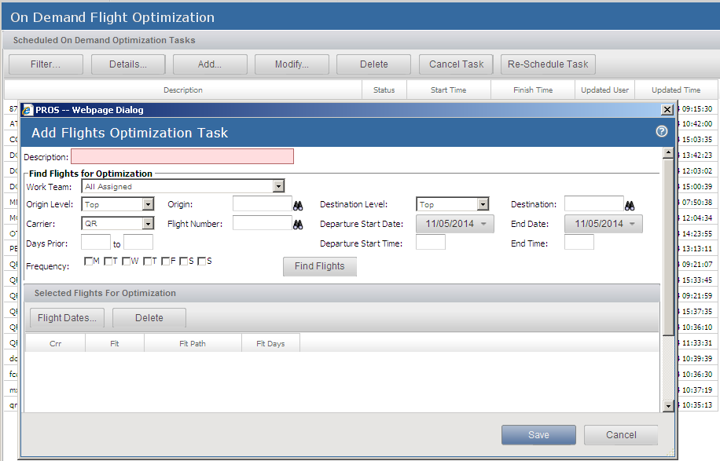
On Demand Flight Optimization
Create queries for selecting groups of flight legs to optimize at the next daily optimization process.

Slide 7
PROS O&D Optimizer
Optimizer Parameters

Slide 8
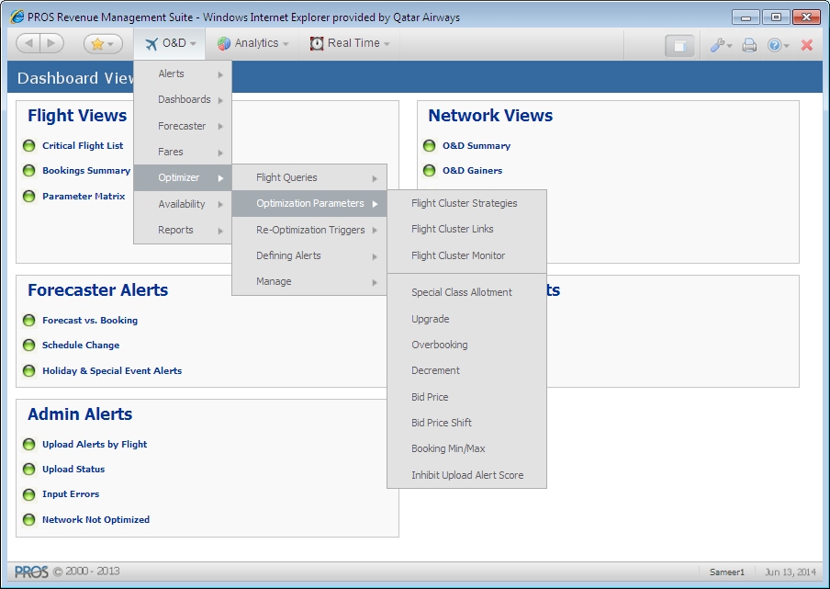
Optimizer Parameters

Slide 9
Optimizer Parameters
PROS O&D users define linkable parameters to influence the optimization processes. Whenever anyone modifies a linkable parameter, PROS O&D re-optimizes the flights to which the parameter is linked.

Slide 10
Optimizer Parameters
Upgrade
Overbooking
Decrement
Booking Min/Max (Not in use for QR)
Bid Price
Bid Price Shift (Not in use for QR)

Slide 11
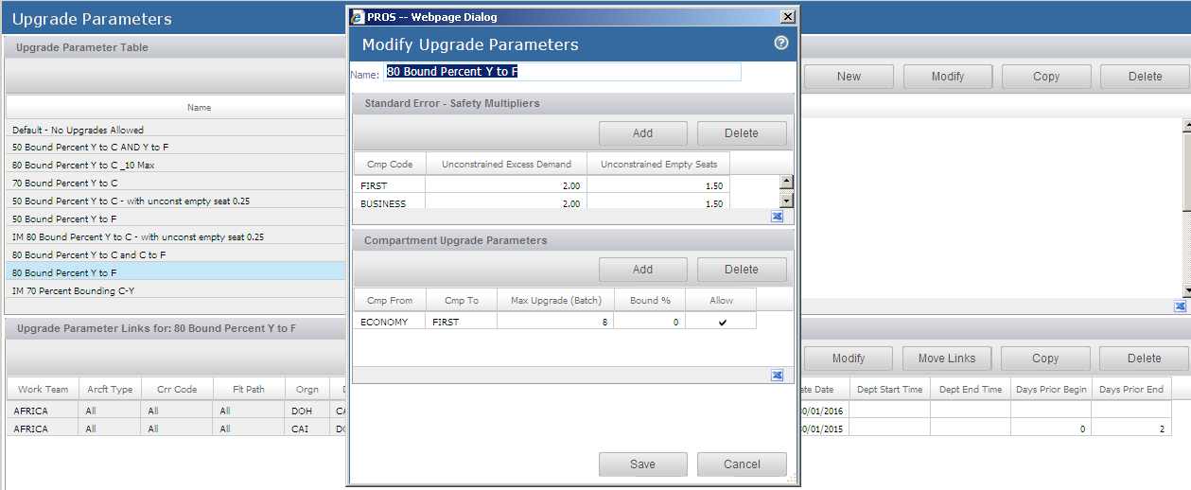
Upgrade

Slide 12
Upgrade
The Standard Error - Safety Multipliers lets you specify the multipliers by which to multiply the forecast standard error used to determine the number of seats to upgrade from a lower compartment to a higher one.
An Unconstrained Excess Demand multiplier raises or lowers the excess demand value for a compartment. The adjusted excess demand is shown as the Fcst Excess Dmd for each compartment in the Compartment list of the Upgrade Decision Support screen.
An Unconstrained Empty Seats multiplier raises or lowers the number of expected empty seats for a compartment. This adjusted empty seats value is shown as the Fcst Empty Sts for each compartment in the Compartment list of the Upgrade Decision Support screen.
Max Upgrade (Batch) – the maximum number of higher-compartment seats that the Upgrade batch process can make available for upgrades from a lower compartment
Bound % – the percentage of a lower-compartment virtual capacity increase by which to decrease the virtual capacity of the higher compartment.
Allow – select this check box to allow upgrades between the two compartments specified in the record

Slide 13
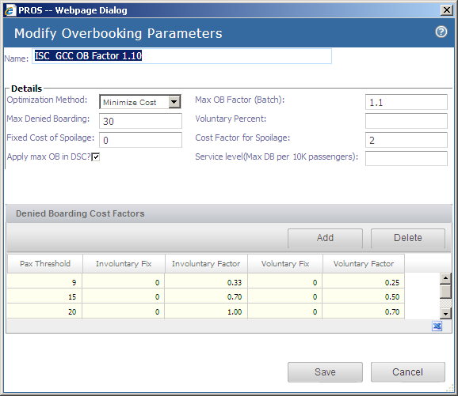
Overbooking

Slide 14
Overbooking
Two methods
Minimize Cost (used in QR) and Maximize Revenue
Max OB Factor (batch) - If the value is set at 1.10, then OB during batch uploading will be limited to 10% (even if the optimal OB is greater than 10%)
Max Denied Boarding - With increase in amount of Overbooking, the probability of DB and Exp. number of DB increases. If the value is set at 5.00, then the OB will be limited to keep the Exp DB <= 5; this limit is based on the number of DB and does not involve cost factor.
Voluntary Percent – Specify the expected percentage of total denied boardings that are voluntary.
Fixed Cost of Spoilage – is the fixed cost associated with one empty seat.

Slide 15
Overbooking
Cost Factor for Spoilage – Factor for increasing or decreasing the estimate of spoilage costs. PROS O&D multiplies a compartment’s average class fare by this factor to estimate the cost of one spoiled seat in the compartment.
Apply Max OB in DSC – Select this check box to apply Max OB Factor (batch) to the AU solution shown in the PROS O&D user interface. If you do not select this check box, the batch process overbooking solution is limited by Max OB Factor (batch), but the solution shown in the user interface is not.
Service Level – Specify the maximum number of denied boardings to tolerate per 10,000 passengers for each flight linked to the Overbooking Parameter table.

Slide 16
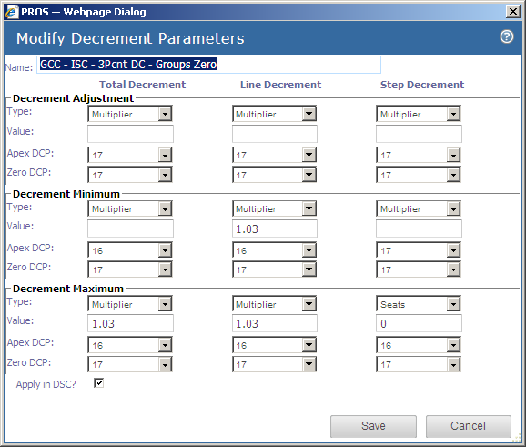
Decrement
Apex DCP – Select the DCP at which the compartment decrement adjustment begins to linearly approach zero. By default, this is set to the final pre-departure DCP.
Zero DCP – Select the DCP at which the compartment decrement adjustment reaches zero. By default, this is set to the final pre-departure DCP.

Slide 17
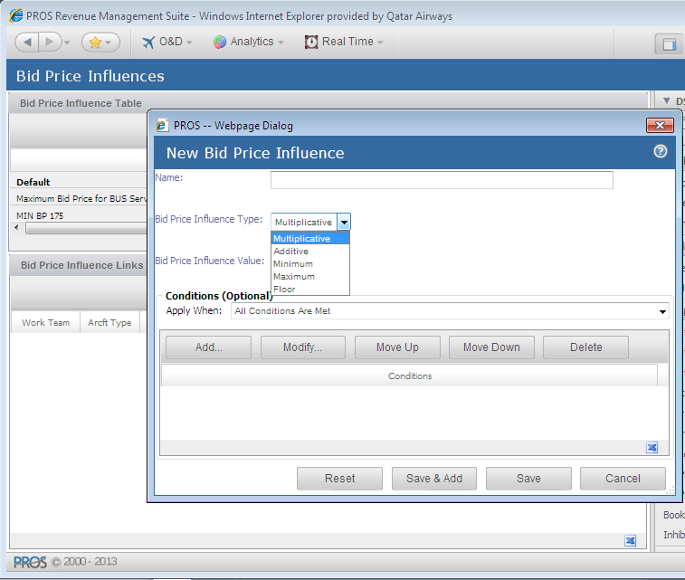
Bid Price
Min/Max, Multiplicative, Additive, Floor Bid Price Influences

Slide 18
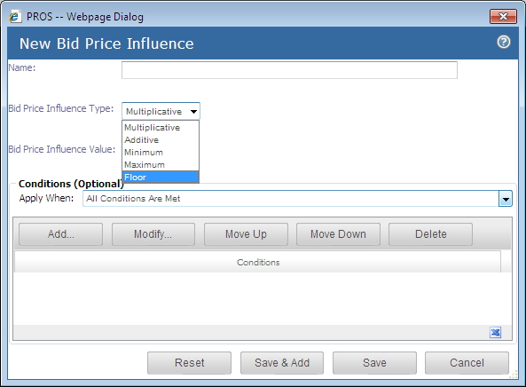
Bid Price Floor - GUI

Slide 19
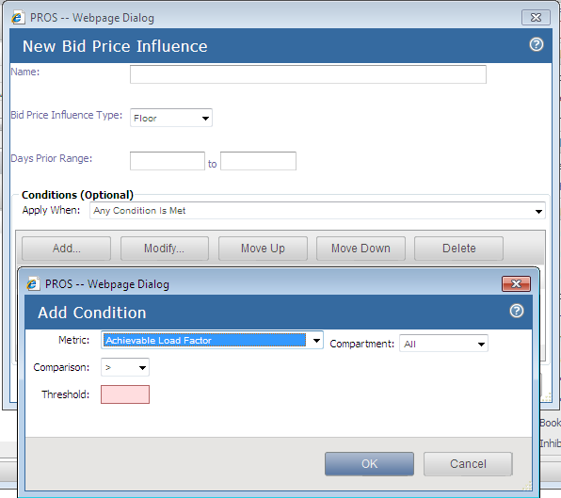
Bid Price Floor - GUI
Define days prior range
Load factor (booked and achievable) conditions

Slide 20
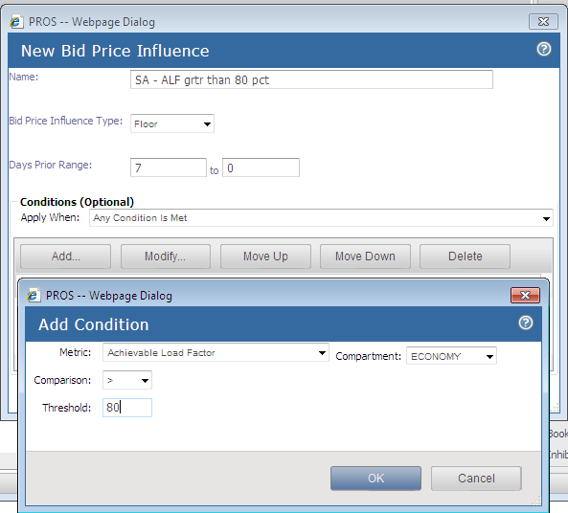
Bid Price Floor - Examples
Achievable LF% specific (DOH-LHR; ALF>80%; 7 to 0 days prior)

Slide 21
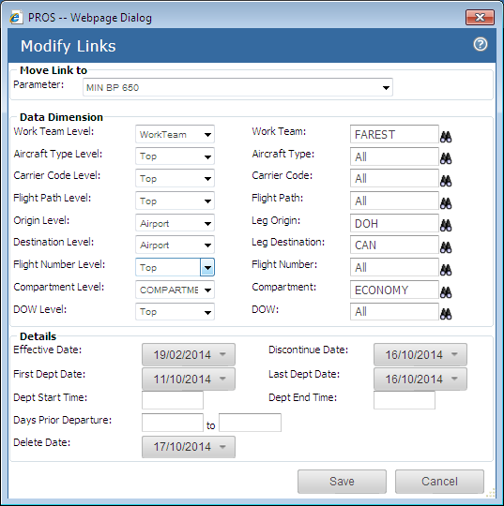
Bid Price Floor - GUI
Linkable to specific market(s)
Linkable to particular compartment

Slide 22
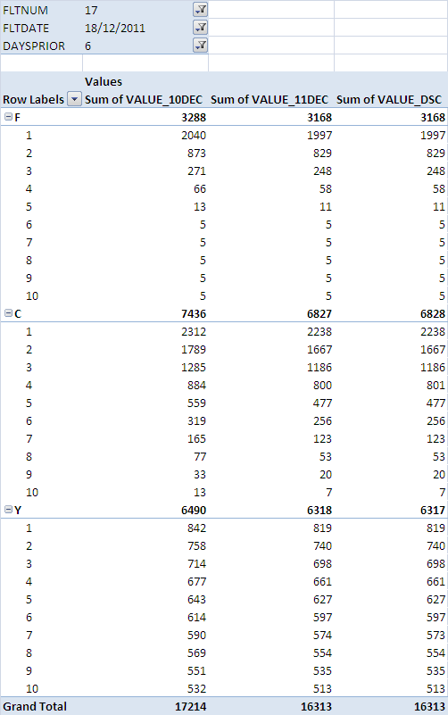
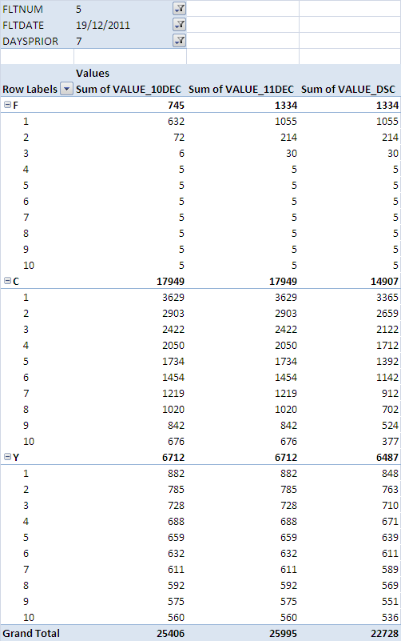
BP floor was not applied
BP floor was applied

Slide 23
Flight Pattern Links
Linking functionality is consistent throughout the system.
Analysts can apply links to flights within assigned work teams using multiple hierarchies.
Link to specific Departure Dates and Time of Day window
Use Days prior to departure in conjunction with departure dates.
Use applicable dates to refine the application of the link
In case of multiple optimization parameters, the most specific applies (the highest weighted pattern will be declared the most detailed)

Slide 24
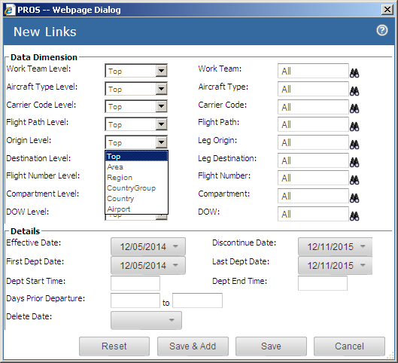
Flight Pattern Links

Slide 25
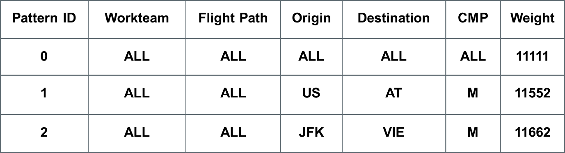
Application of Optimizer Parameters
Rules for Determining Detailed Hierarchy
Assume that Workteam has 2 levels, Flight Path has 2 levels, Origin and Destination each have 6 levels and Cmp has 2 levels.
The Dimension Manager assigns a weight to each dimension to determine the most detailed.
e.g. the Origin dimension has 6 levels: Top (1), Area (2), Region (3), CountryGroup (4), Country (5), and Airport (6).
Each dimension has an assigned weight. The total weight for each pattern is shown below:

Slide 26
Application of Optimizer Parameters
In case of multiple optimization parameters, the most specific applies (the highest weighted pattern will be declared the most detailed)
Therefore, in the previous table, pattern 2 will be the most detailed.
Since default links are defined, each entity will have at least one link (the default). If an additional link is defined using pattern 2 above, the new link will be picked since it is the most recent.

Slide 27
PROS O&D Optimizer
GUI Overview

Slide 28
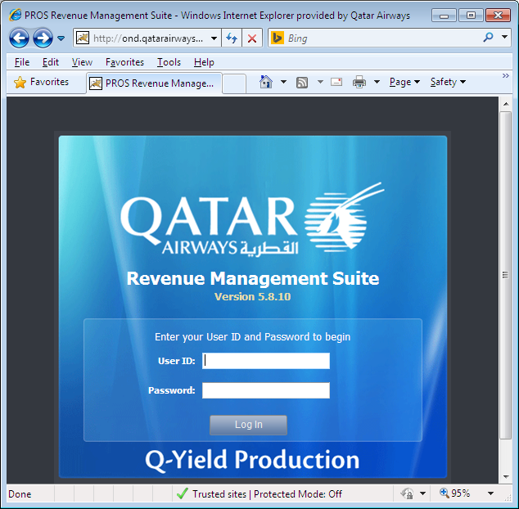
Log-in Page
http://ond.qatarairways.com.qa:9095/prosrm/oandd

Slide 29
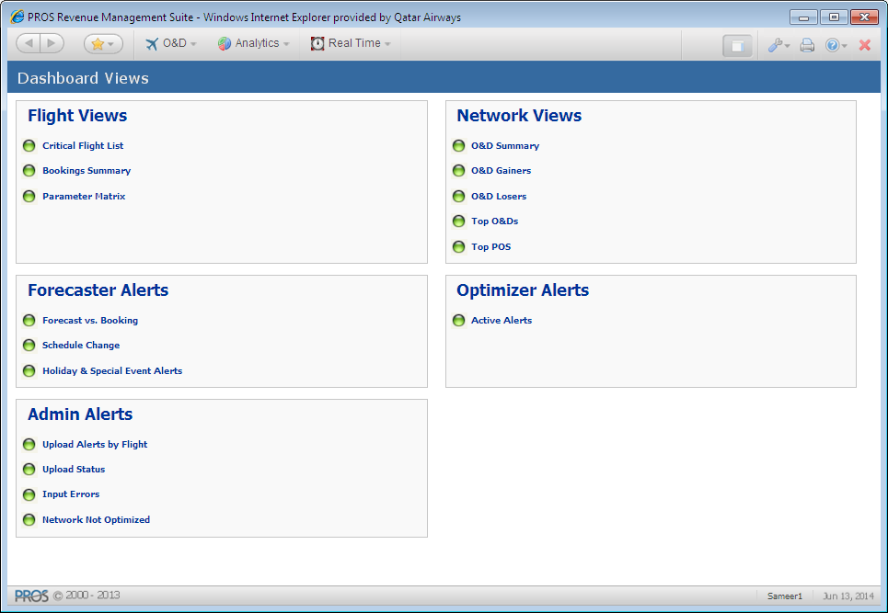
Application Home Page

Slide 30
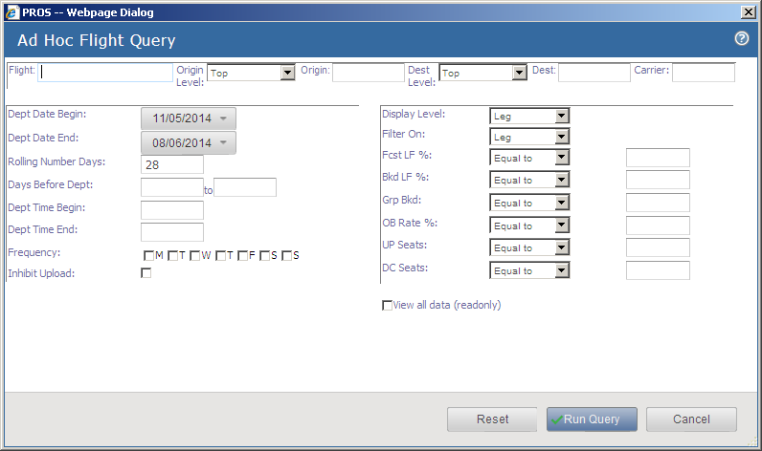
Optimizer – Flight Query
User Defined Criteria to show flights and access DSC. Users can save the query and simply rerun.

Slide 31
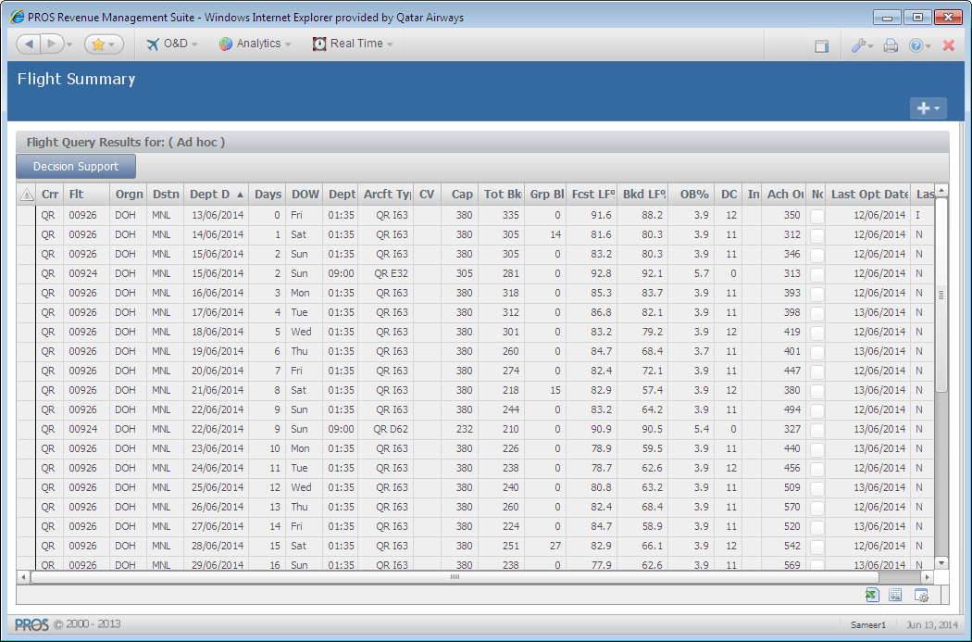
Flight Summary
Highlight a particular
flight to view the
DSC Screens

Slide 32
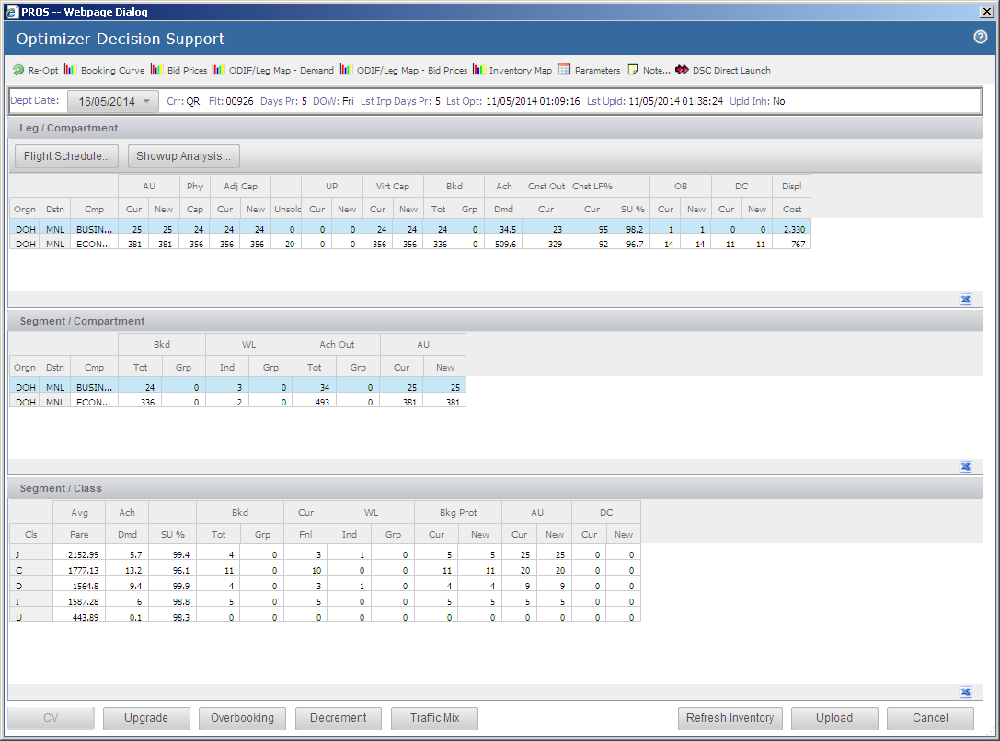
DSC Screen
Drag and Drop

Slide 33
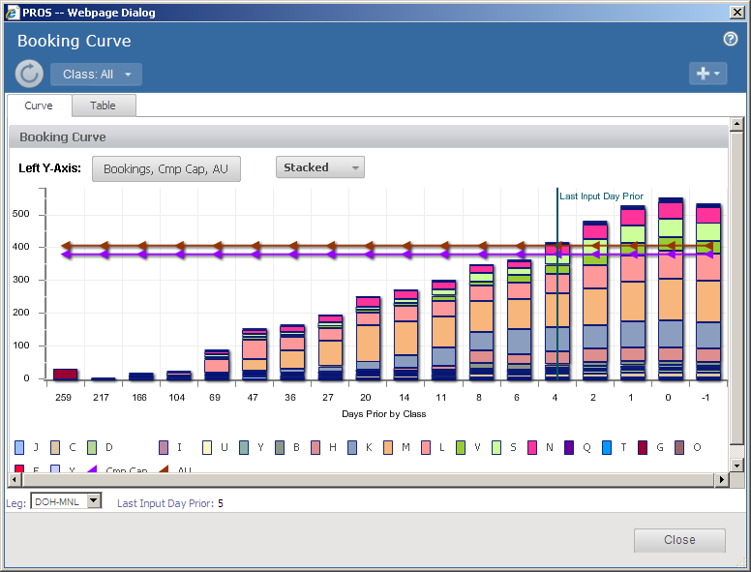
Booking curve
Displays the class booking demand for a selected leg segment and compartment over the DCPs for the flight/departure date.
Bars with solid colors represent actual bookings for past DCPs. Bars with hatched colors represent forecasted demand for future DCPs.
Straight horizontal lines,
Cap represents a compartment's new virtual capacity or the aircraft's new adjusted capacity
AU represents the compartment or aircraft's AU

Slide 34
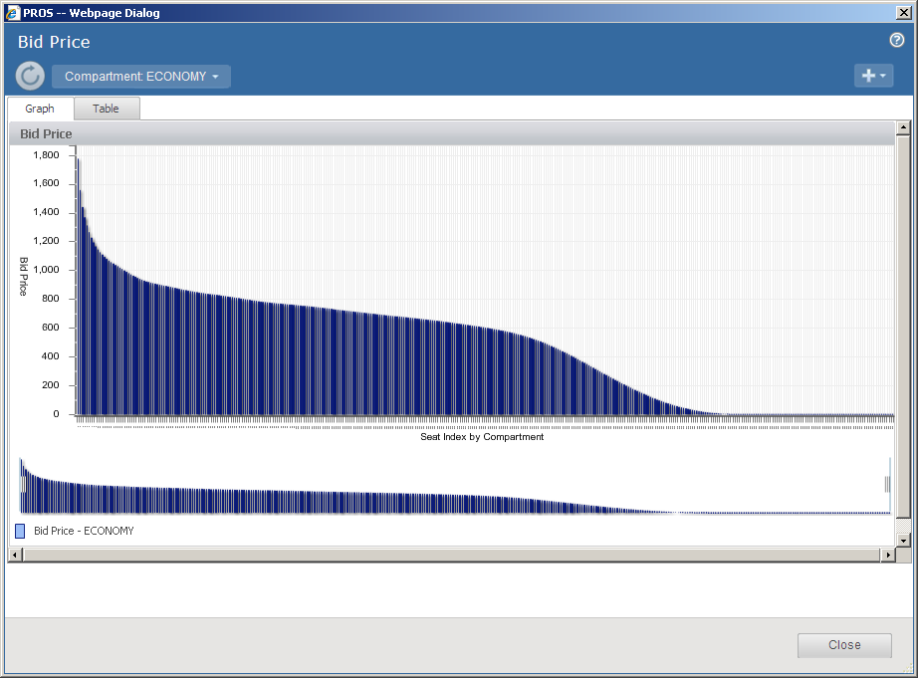
Bid Price

Slide 35
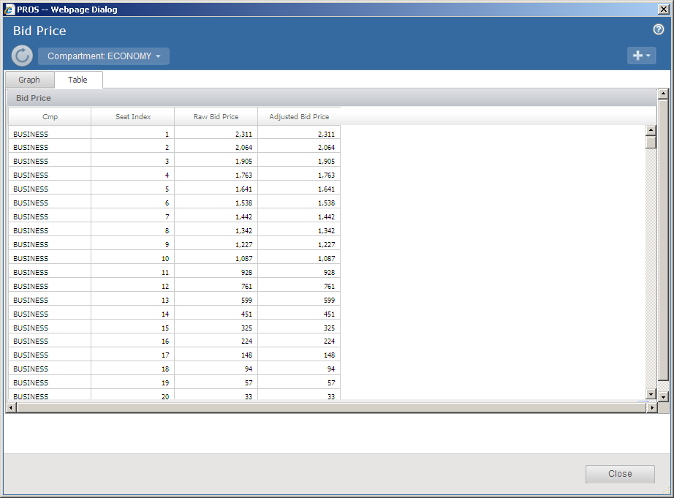
Bid Price
Displays the Bid price vector for each seat within each compartment up to the AU level

Slide 36
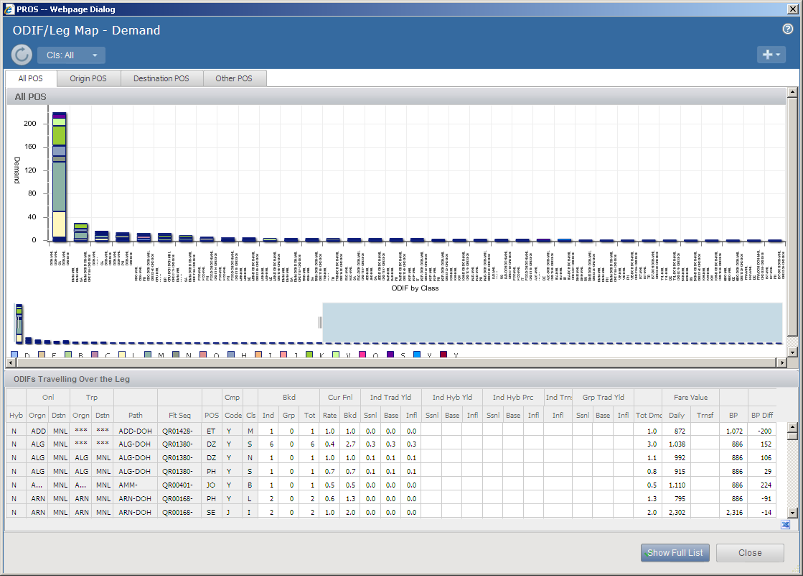
ODIF/Leg Map - Demand
Displays demand for various ODIF/ POS competing for a seat on the flight/ leg
Path and Flights column display the complete path and Itinerary

Slide 37
ODIF/Leg Map - Demand
Cur Bkd, Cur Fnl Rate, New Dmd, and Tot Dmd are outputs from O&D Demand Forecaster
FV Fare (Daily Fare) is an output from Fare Valuation.
Bid Price is an output from the Optimizer.
Bid Price Diff is Fare minus Bid Price.
Negative Bid price difference indicates a booking request will be rejected.

Slide 38
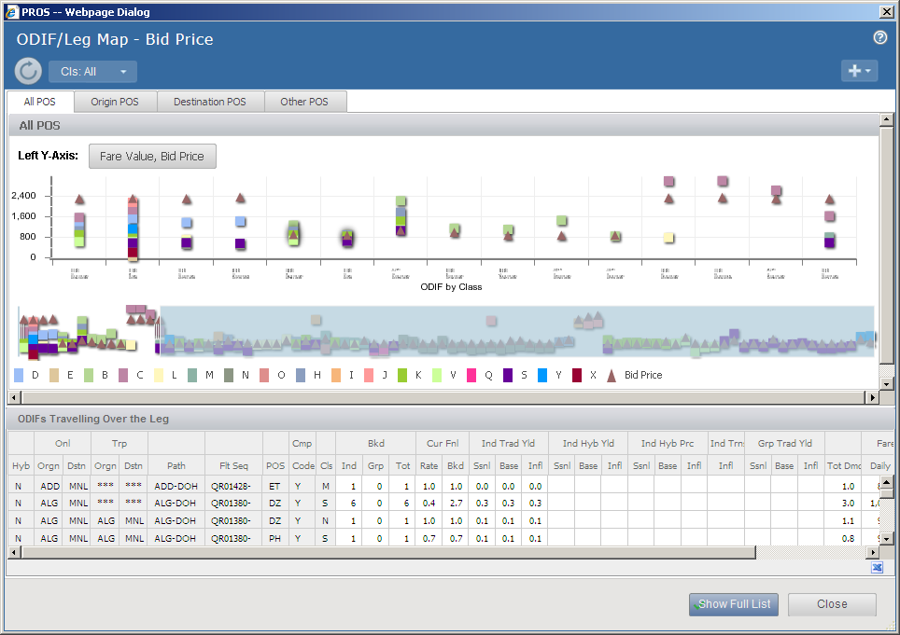
ODIF/Leg Map – Bid Price

Slide 39
ODIF/Leg Map – Bid Price
This screen is accessed by ODIF Leg Map - Bid Prices.
It is a graphical representation of classes that are closed or open for sale for each ODI POS entity.
Classes above the watermark are open for sale for the entity.
The watermark value represents the sum of the (applicable) Bid prices for all flight legs in the specific OD itinerary.

Slide 40
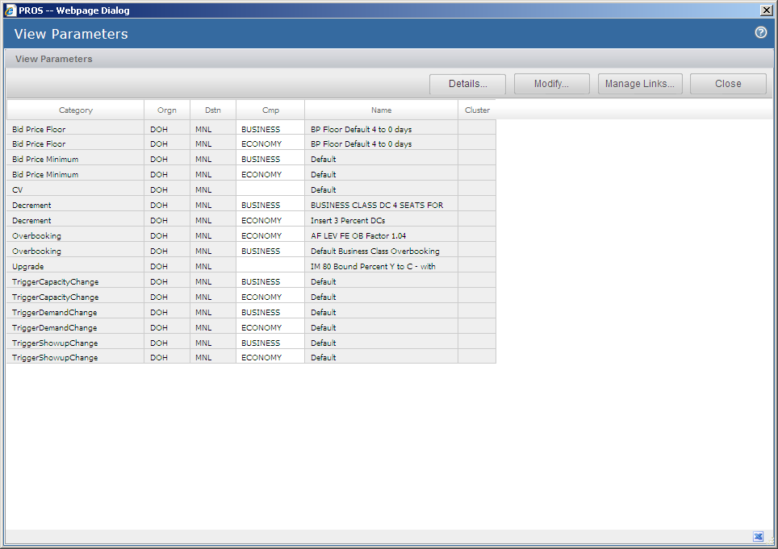
Parameters
Parameters window displays all of the input, alert and re-optimization parameters linked to the flight leg displayed

Slide 41
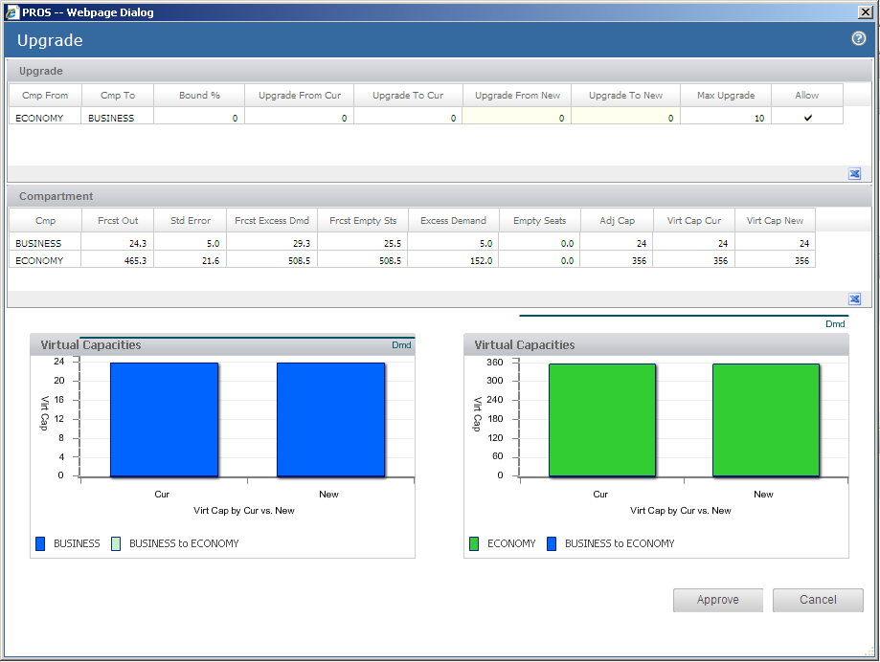
Upgrade Optimization
Upgrade recommendations are shown on the under Upgrade Cur/ New columns
The Vrt Cap (Cur/ New) column shows the result after upgrade

Slide 42
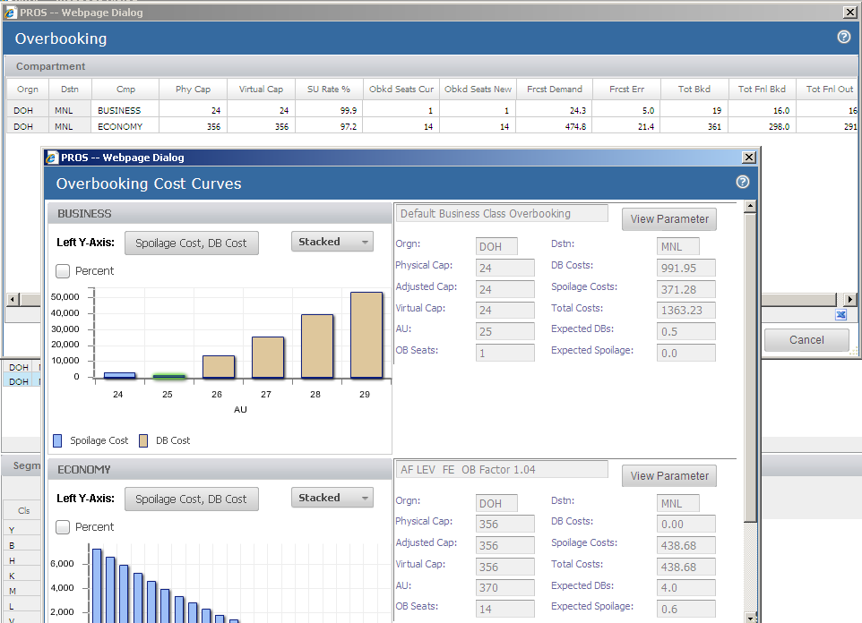
Overbooking Optimization
Figures shown on the left are Cost Curves for First, Business and Economy compartments; these AU values have the lowest Total Cost.
If the mouse is moved over the vertical bars, the cost of Exp DB and Exp Spoilage for other AU’s will be displayed.

Slide 43
Decrement Optimization
Selecting Decrement (class) presents the class-level decrement display. User adjustments to the New solution are made at this level
Segment class level decrement values are aggregated to the leg compartment level
Compartment DC apex DCP is set to the earliest class apex DCP
DP (dynamic programming) requires the AU level for the compartment as input; not the AU level for class

Slide 44
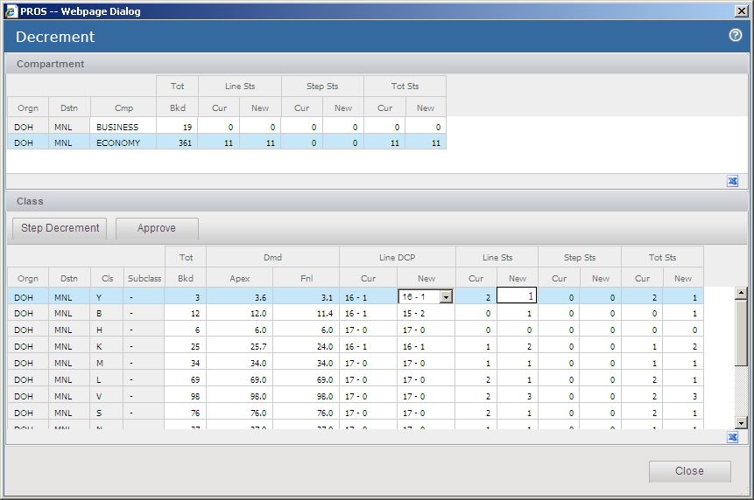
Decrement Optimization

Slide 45
Traffic Mix
The Traffic Mix screen displays new and current protects and AUs for the flight displayed in the Decision Support Center and lets you override the protects.
The Traffic Mix optimizer determines protects and AUs based on compartment overbooking AUs and the optimized bid prices in bid price vectors.

Slide 46
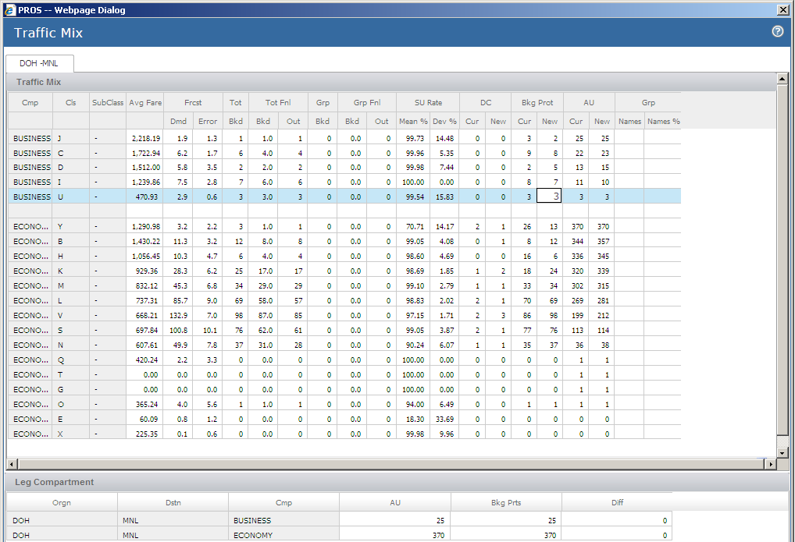
Traffic Mix
Notes:
Avg Fare – the average fare
Frcst Dmd – the forecasted final demand
Frcst Error – the standard error of the demand forecast
Tot Bkd – the current total individual and group bookings
Tot Fnl Bkd – the current final booked, which is the number of currently booked passengers who are expected to remain booked on the departure date
Tot Fnl Out – the current final out, which is the number of currently booked passengers who are expected to board the flight
Grp Bkd – the current group bookings
Grp Fnl Bkd – the current group final booked, which is the number of currently booked group passengers who are expected to remain booked on the departure date
Grp Fnl Out – the current group final out, which is the number of currently booked group passengers who are expected to board the flight
SU Rate Mean – the mean show up rate
SU Rate Dev – the standard deviation of the mean show up rate
Bkg Prot Cur – the current number of booking protects
Bkg Prot New – the new, not yet uploaded, number of booking protects; this can be either the Traffic Mix optimizer's recommendation or a user override
AU Cur – the current AU
AU New – the new, not yet uploaded, AU; this can be the Traffic Mix optimizer's recommendation, or it can be based on a user override to the Bkg Prot New

Slide 47
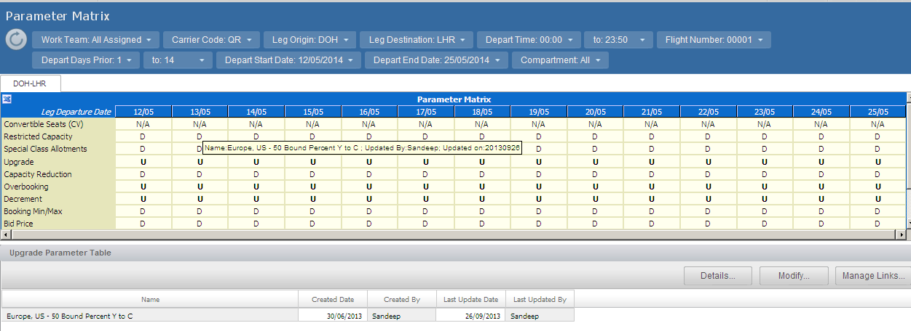
Parameter Matrix
Summary of all parameters applied to a flight for a selected range of departures

Slide 48
Alerts
Alerts are defined using the available Metrics.
Alert Types
Created by team
Entered by System Administrator
Many alerts may be created but only six selected as critical alerts
Alert Definitions
Created by Analysts
Linked to flights by Analysts
Alerts can be viewed in the Alert Summary Screen

Slide 49
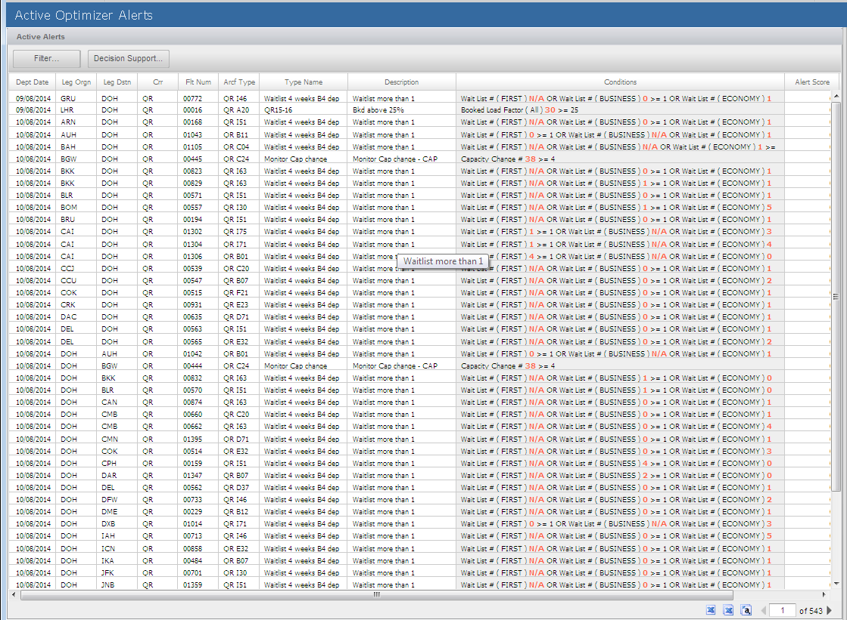
Active Optimizer Alerts

Slide 50
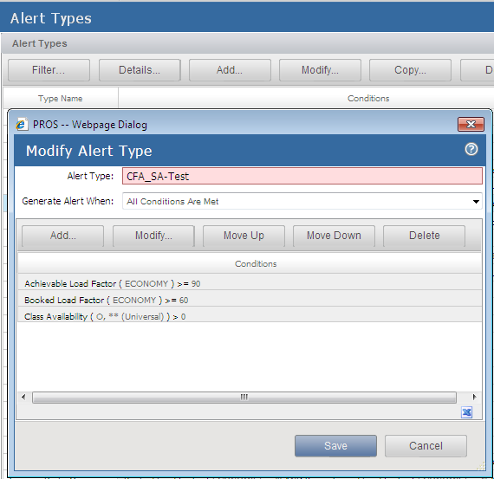
Alert Types
1 – Create An Alert Type.

Slide 51
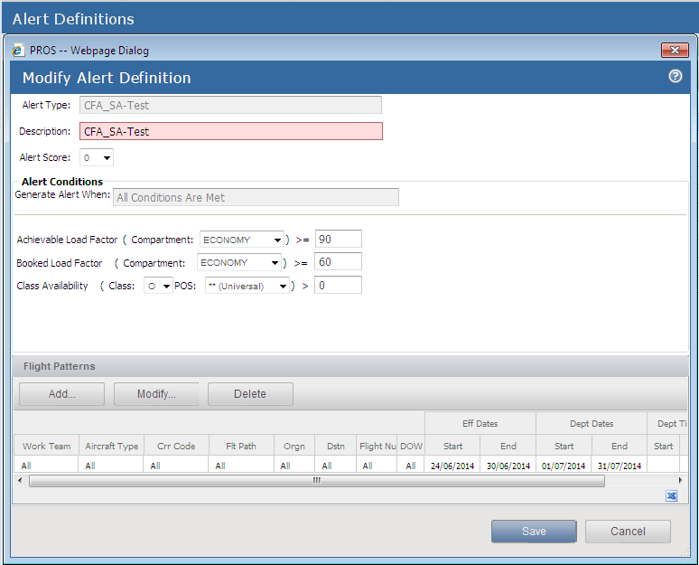
Alert Definition
2 – Create Alert Definition for the Alert Type

Slide 52
Critical Flight List
Contains vital information about flights that have critical alerts.
- Use this screen to review flights that are outside normal expected thresholds.
- Up to six alert types can be defined as critical.
- Definition applies system wide.
- 3-letter abbreviations used for alerts are set by the System Administrator.

Slide 53
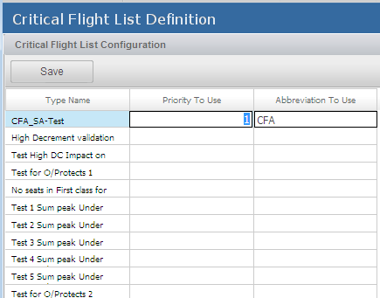
Critical Flight Definition
3 – Create Critical Flight Alert Definition
(Only users with System Administrator access can update this screen)

Slide 54
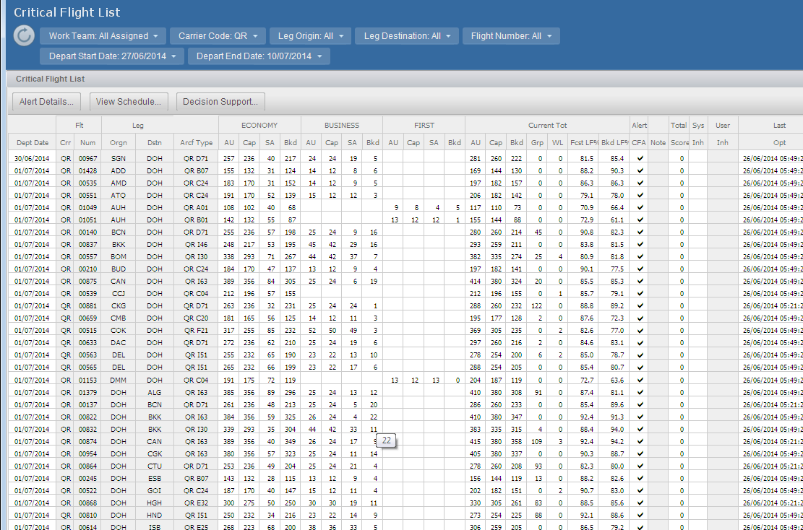
Critical Flight List

Slide 55
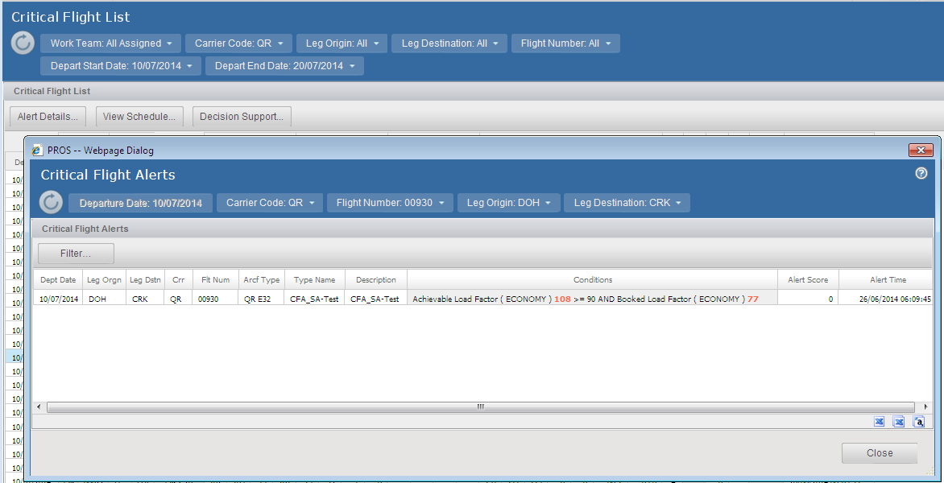
Alert Details
Alert Details: Displays details for all critical alerts triggered for highlighted flight.

Slide 56
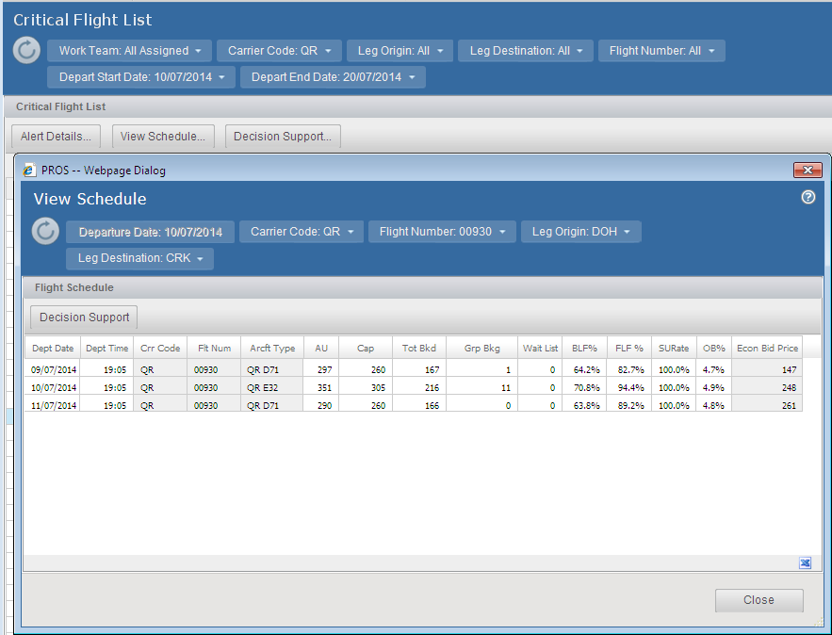
View Schedule
View Schedule: Displays schedule and vital flight information for departures 1 day before, day of and 1 day after for market of flight highlighted.

Slide 57
Decision Support
Decision support: Central Display to review all flight details and system recommendations.

Slide 58
Questions?

Slide 59
Thank you..!

